Slide 1
Traction – A Long Read LIMS
Harriet Craven
Steve Inglis
Notes:
Why: Steve
How: Harry
Now: Steve
Coming soon: Harry

Slide 2
WHY

Slide 3
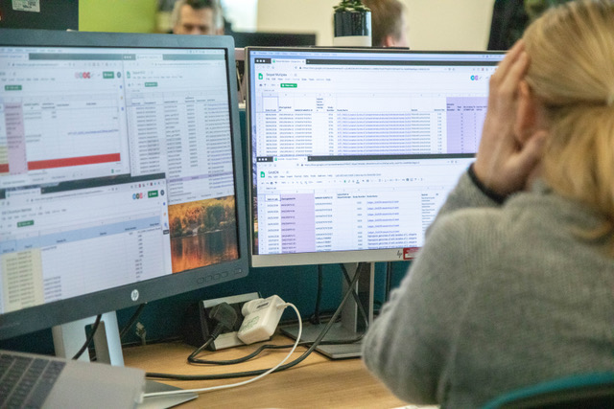
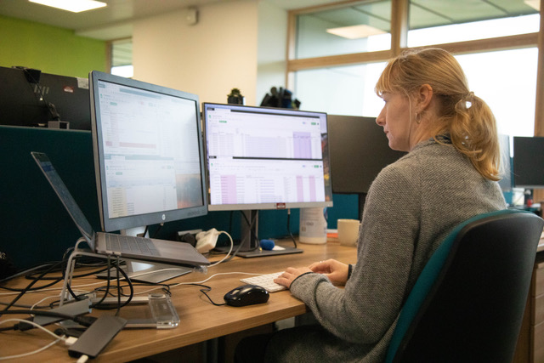
"We need a LIMS so that my full time job is not inputting info into Google Sheets"
“We have gone from tracking 10s of PacBio samples per month to trying to keep on top of >35 per month. When we start processing >35 per week it will be a close call between google sheets breaking or one of the team. Place your bets...”
Notes:
This is Karen. I have been in the same office as Karen for 3 years and throughout that whole time she has been crying out for a LIMS to track her work.
It has never been a priority because her work is bespoke and low throughput. She needs a LIMS so her full time job is not inputting info into Google sheets
That has all changed …
Craig: “We have gone from tracking 10s of PacBio samples per month to trying to keep on top of >35 per month. When we start processing >35 per week it will be a close call between google sheets breaking or one of the team. Place your bets...”

Slide 4
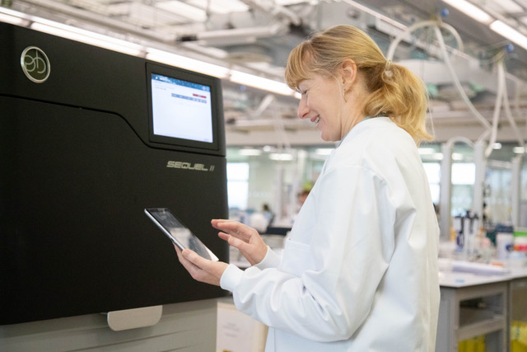
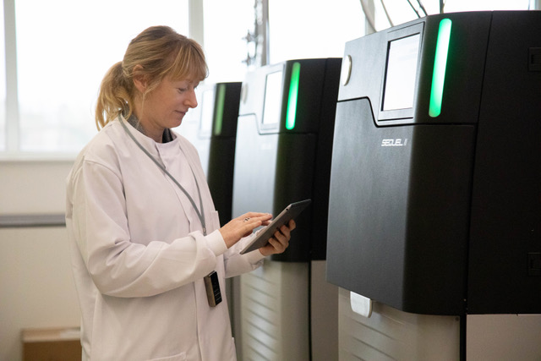
First there was Excel , then Google sheets, finally Traction
Notes:
This is how we envisage life for Karen with a LIMS which allows her to track her work.
In her natural environment; in the lab, looking happy and no Google sheets!
Just an iPad with LIMS and a 2D scanner.

Slide 5
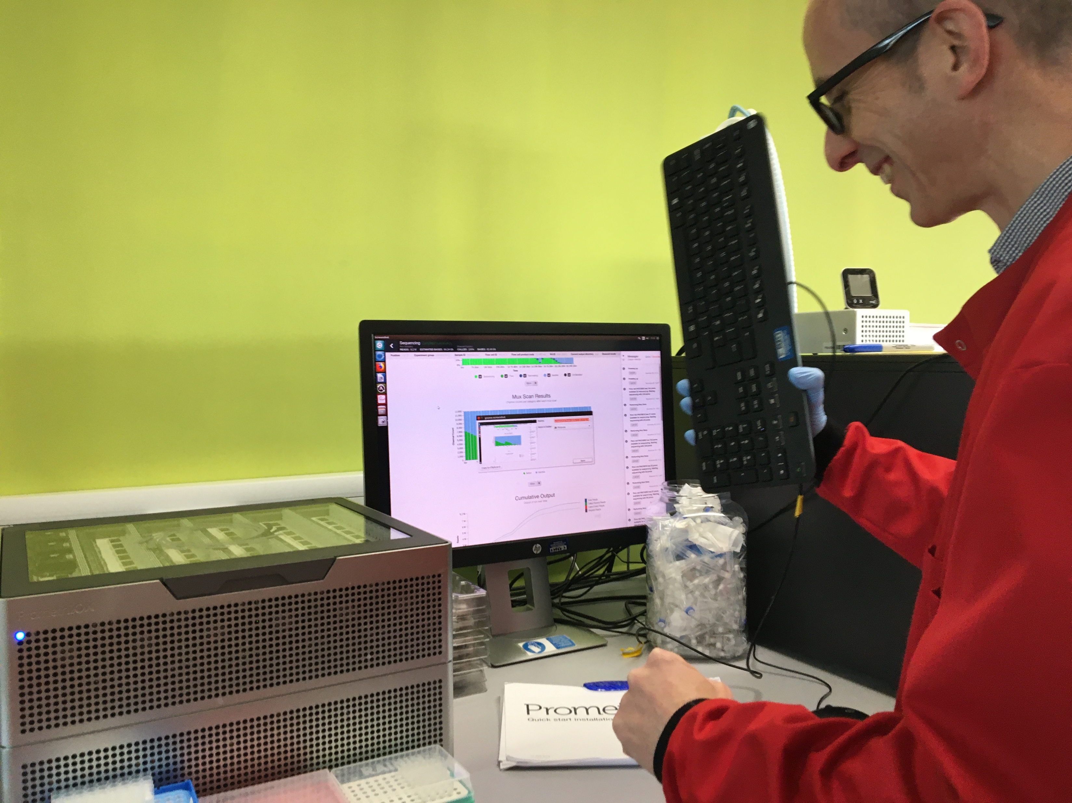
New Pipeline Group (NPG) | DNA Pipelines Informatics
We need to know what, when and where …
Notes:
This is Keith. Keith works in NPG.
He needs to be able to match sample data against the sequencing data. He also needs to make sure that they have got all of the data and what runs to expect. At the moment he has to do this manually and as you can see he gets frustrated. A LIMS will help him to gather the data in a more maintainable and less time consuming way.
No Promethions were hurt in the making of this image.

Slide 6
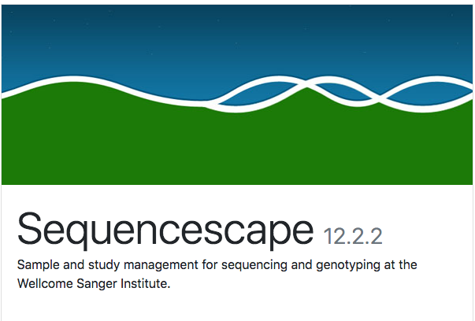
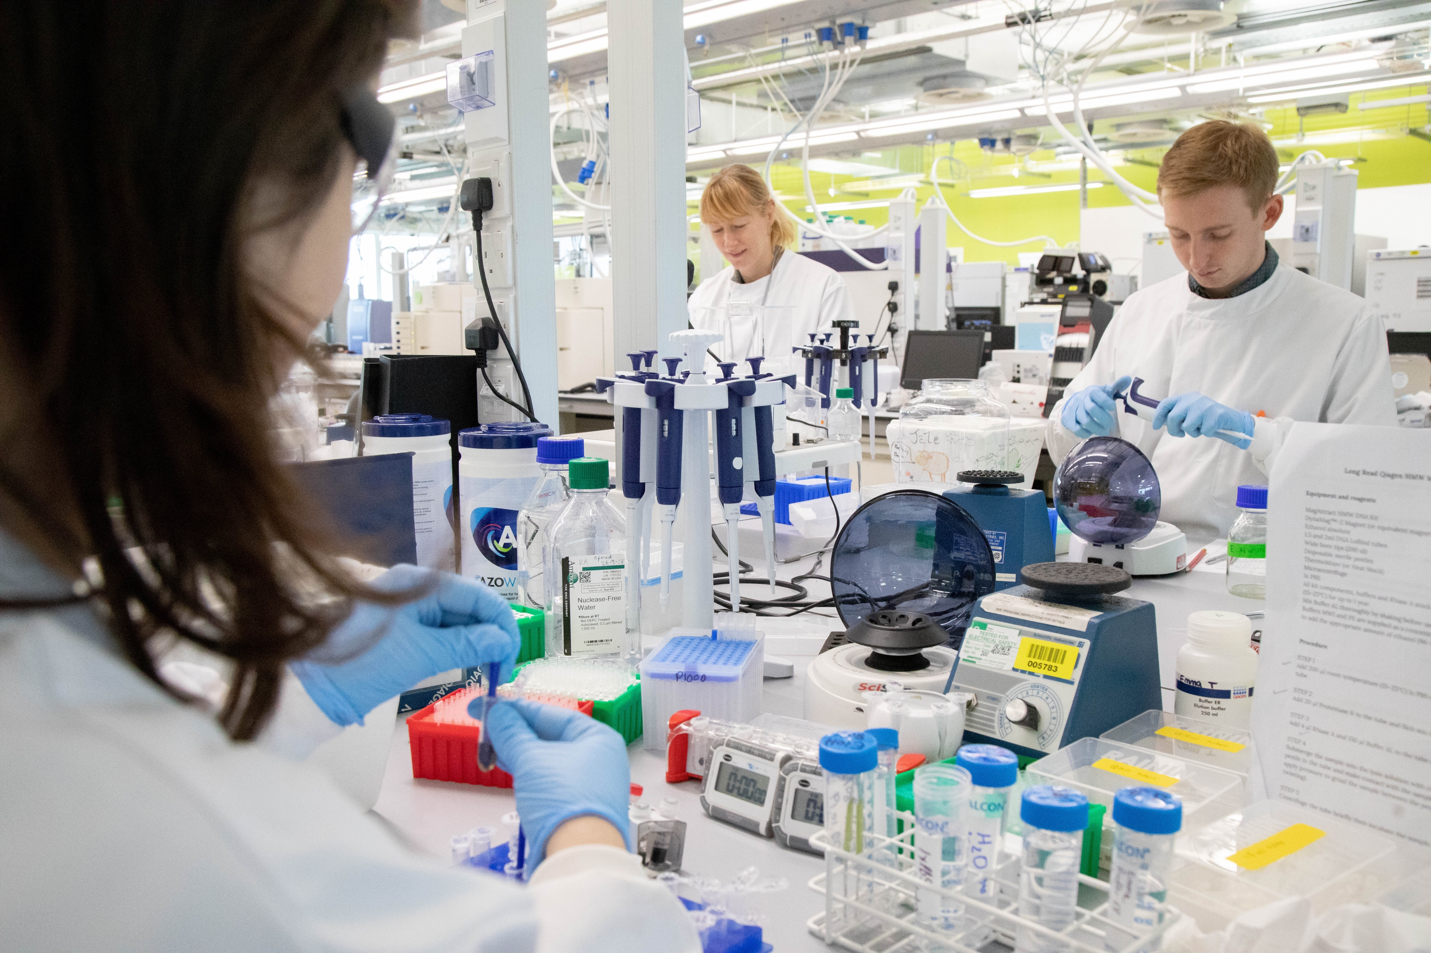



Faculty
R & D
Operations
External Partners
Notes:
Operations - Need a central place to track long read samples. Tree of Life – process 66000 samples over 10 years
Why not Sequencescape? Sequencescape models the short read domain well but does not work well for the long read model. We tried it with PacBio and it didn’t work.
R&D - With LIMS tracking they will have all of the historical data which we can be correlated with the sequencing data to give them an idea of how we can improve pipelines in the future.
Faculty – need to be able to correlate samples with output, need to know where samples are in the workflow and also need to know whether there is enough sample left for further analysis. They would also like QC information. With a LIMS we can provide them with that information easily.
External Partners - The Sanger Institute will serve as a hub for sequencing and genome assembly, annotation, data storage and data release. LIMS will be a crucial part of that.

Slide 7
HOW
Notes:
Talk about what we have implemented so far

Slide 8
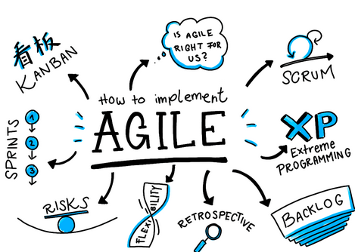
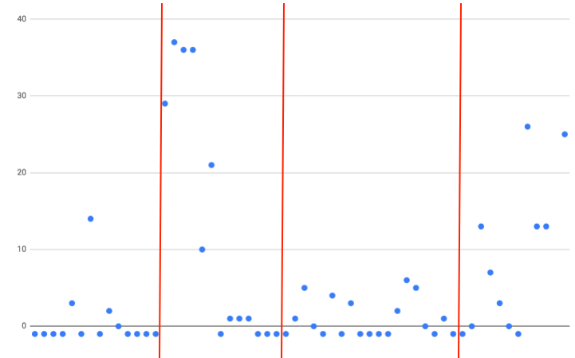
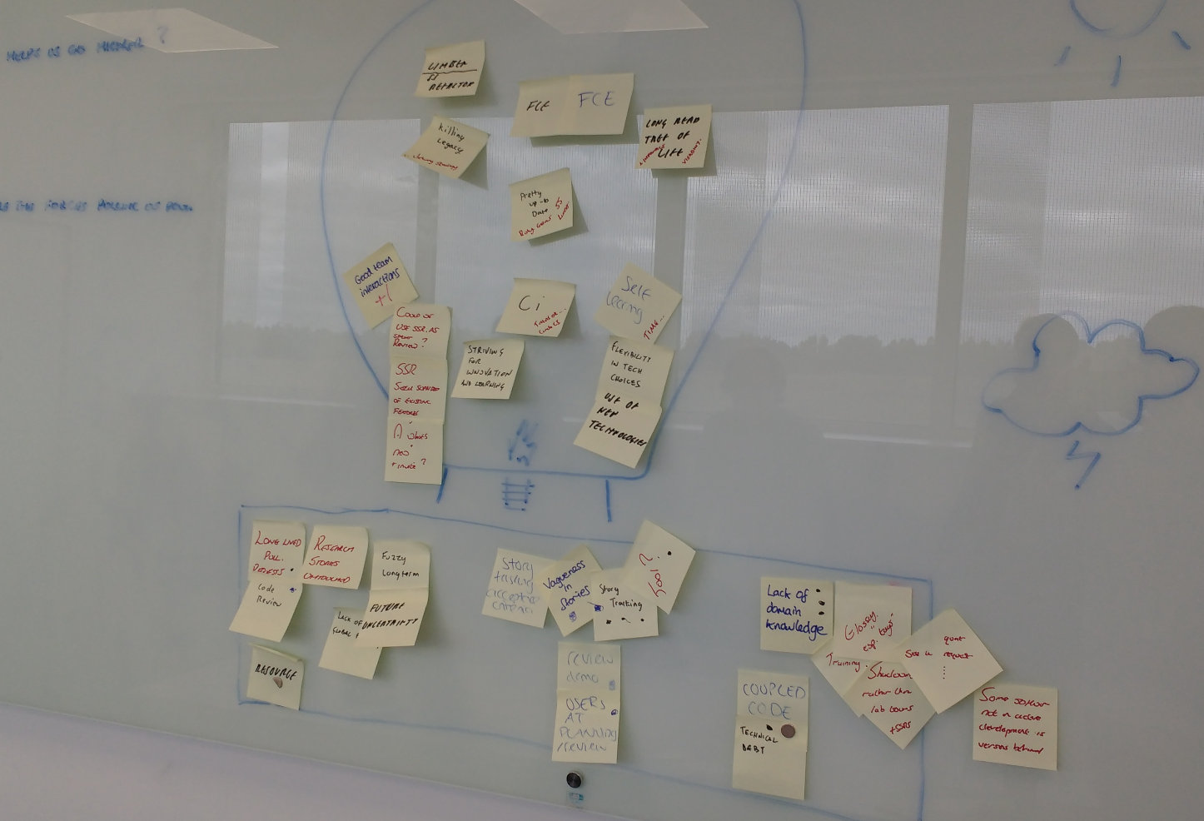
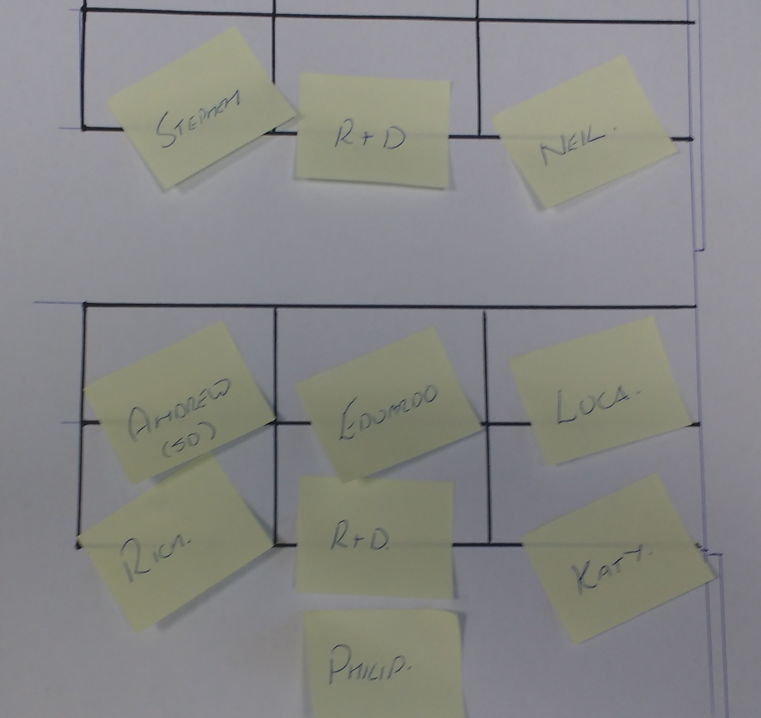
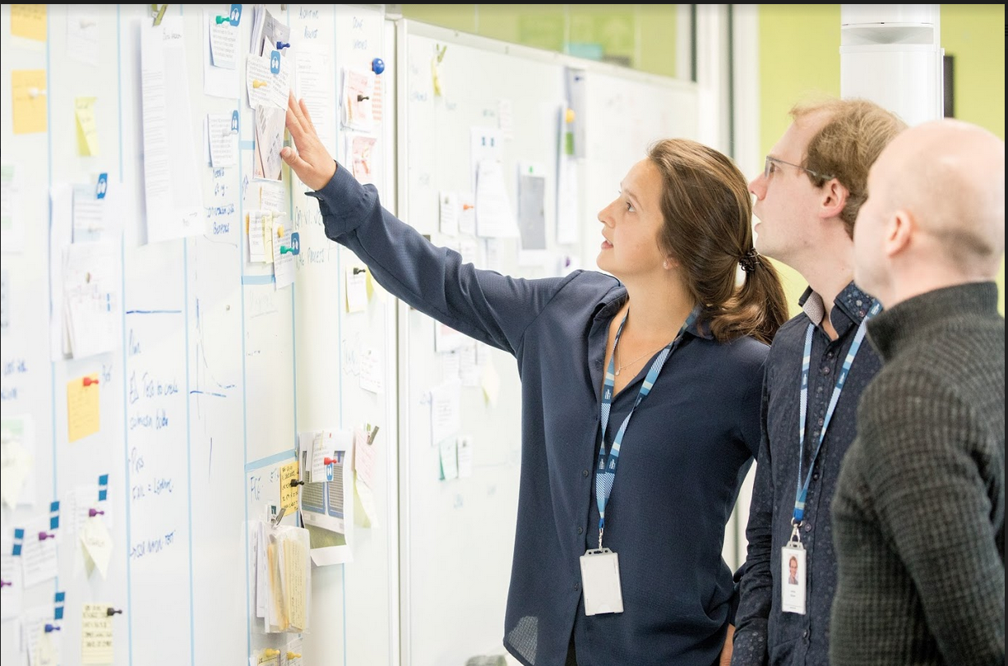
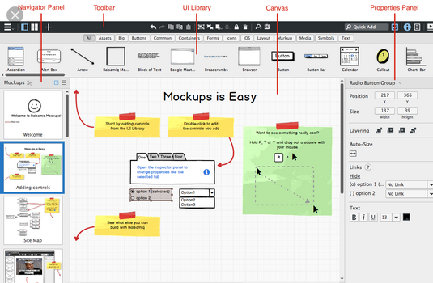
Development Process
Notes:
(As Rich mentioned)
work using Agile as a framework
product owner prioritises stories back log
Tasking / prototyping / mocking up
code review, merge, goes through user acceptance testing
deployment process
FCE, Ansible Terraform to provision, configure and deploy
Briefly exCycle time metric – how quickly we are delivering stories
Team esimate task size and complexity
Work in development process – shows us we are good as estimating
Shows we have improved as a team tp deliver feature
product
This cycle repeats every two weeks
daily stand ups to keep each other informed of the stories progress, any questions etc

Slide 9
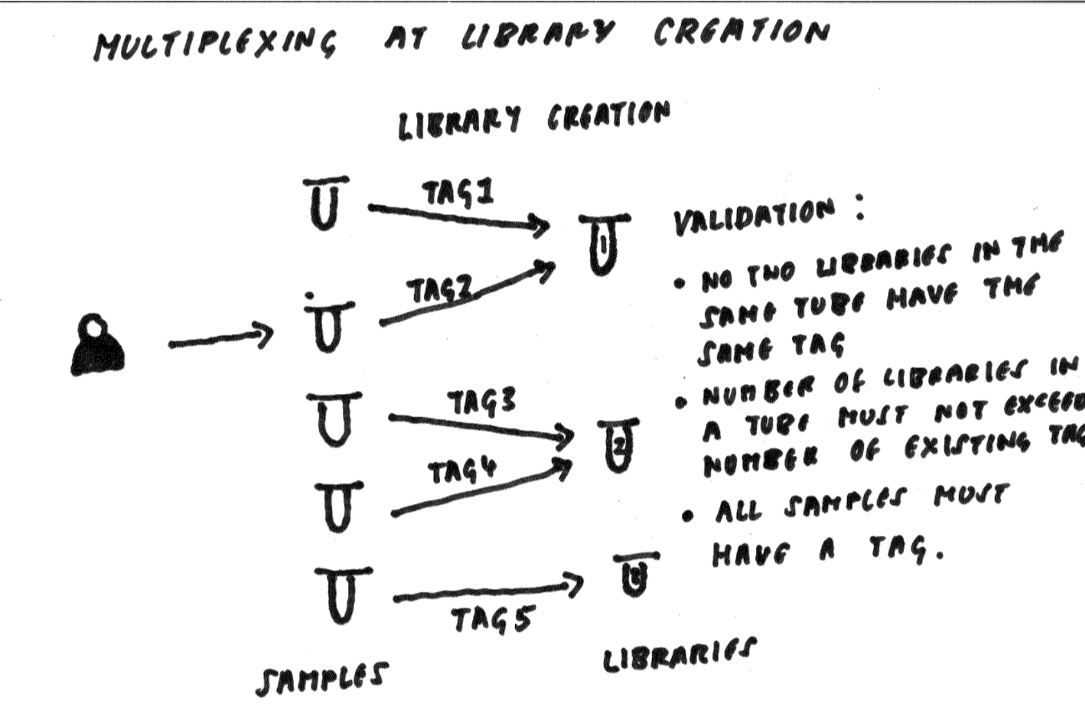
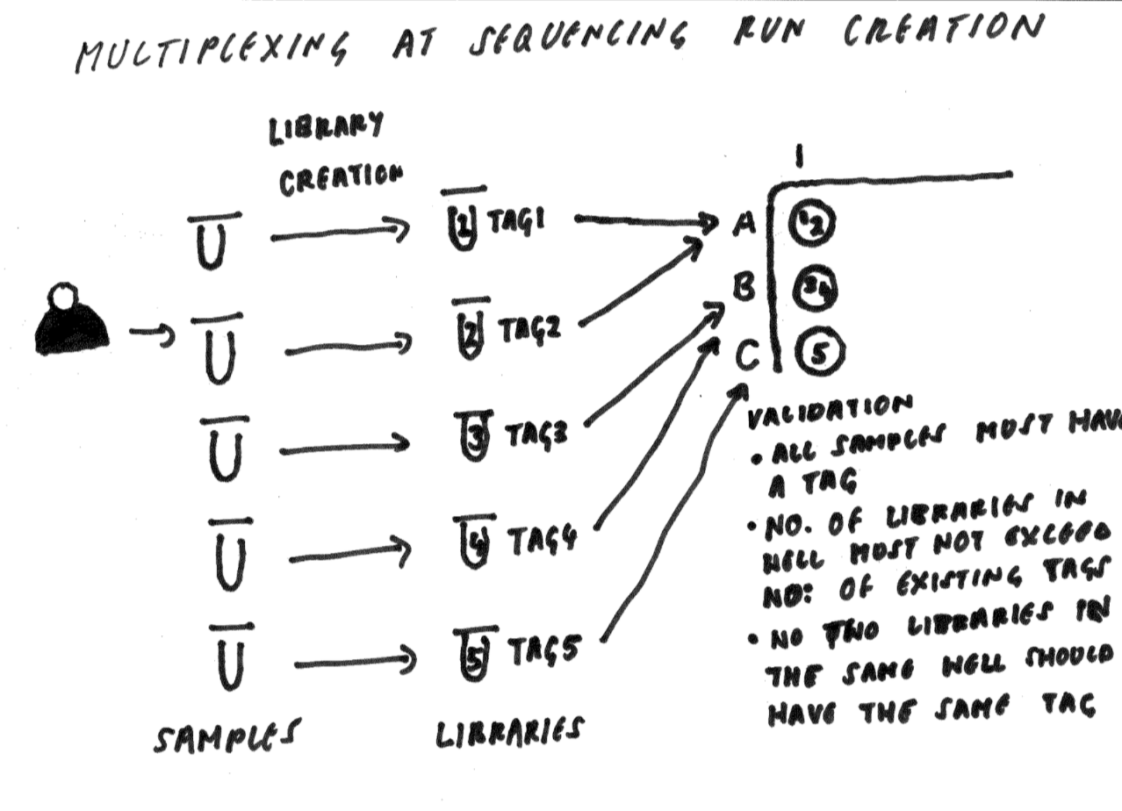
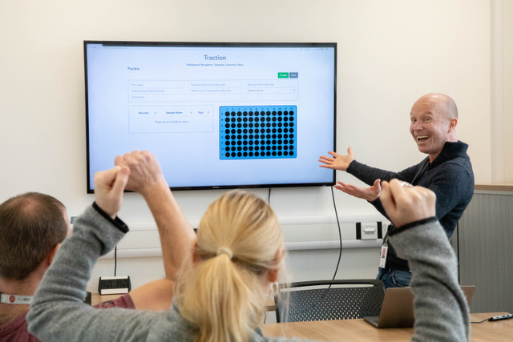
Customer Interaction
Notes:
Another main element in development
customer interaction
Demo-ing feature
regular feedback
diagrams understand requirements – knew exactly what they need / deliver value
Spike for Pacbio Multiplex meeting – Craig said it was brilliant / helped visually communicate process works and what is necessary for the LIMs
Craig said: We realised from this meeting that they only needed to add Multiplexing at Sequencing Run creation which saved both sides a lot of time and effort and meant that we could get to MVP much quicker.

Slide 10



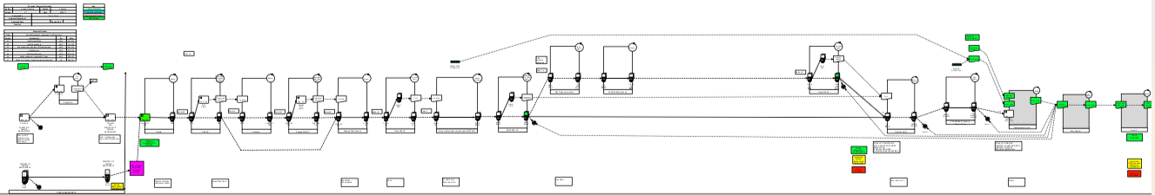
What we learnt to do better
Notes:
Things we could do better
Within the team:
Communication
Team over two offices
Slack has been great
Better planning and tasking – removing ambiguity
Also as previously mentioned
Trying to improve customer interaction
Hopefully stop us from making any wrong assumptions
Half was through first release developer
Realised the process should be barcode driven
On to, where Traction is at NOW

Slide 11
NOW

Slide 12


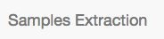

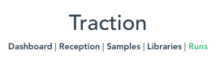
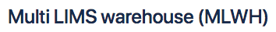
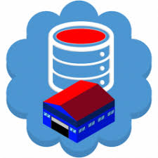
Architecture
Notes:
Sequencescape – Acts as a sample reception. Data provided by customers in sample manifest which contains associated metadata and allows samples to be attached to studies and projects. Used to record scientific objectives and data release policy. Receiving material from collaborators with material provenance ( porters value chain – inbound logistics).
Samples extraction – used to track samples through the DNA extraction process (porters value chain – operations)
Traction – used to track samples through long read pipelines. Will also be used to report on material progression and in the future to capture charging points. It will export the data to MLWH (porters – operations)
MLWH - Marshalling identifier information and product metadata to facilitate downstream processing (porters – outbound logistics)

Slide 13
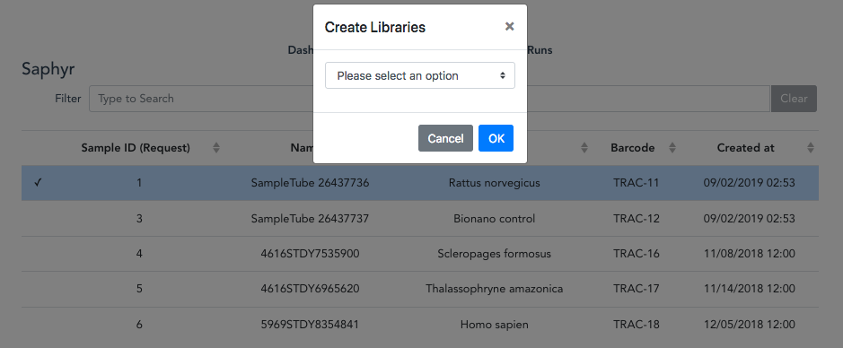
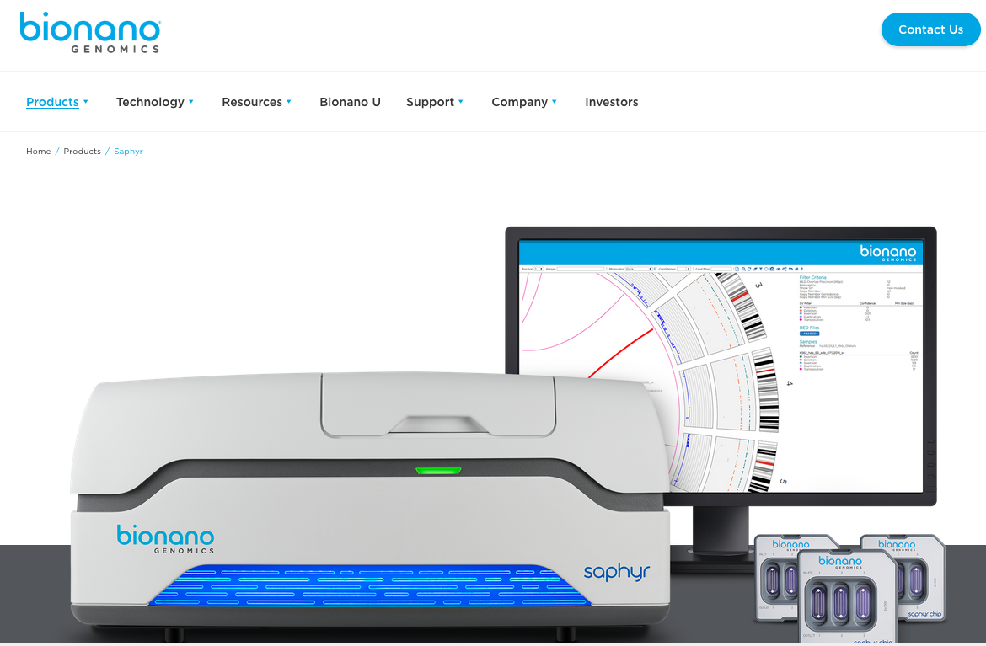
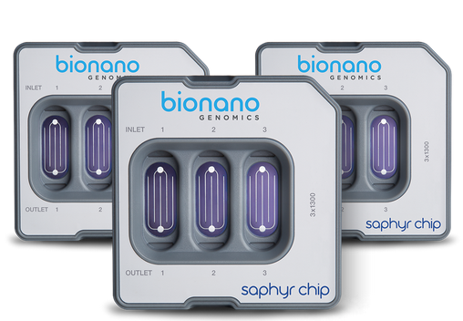
Saphyr
Notes:
Went live 6 months ago. Only 23 runs in Saphyr
Nothing recently because of Saphyr instrument faults The software has recently been updated which allows a bigger throughput per chip and they are going to do a troubleshooting run to ensure the instrument is working ok. The problem could be related to samples, chip or reagents so the plan is to recommence samples so hopefully the pipeline could be up and running again soon.
Traction allows you to - Import samples from samples extraction, create libraries, create sequencing runs and export data to the MLWH

Slide 14
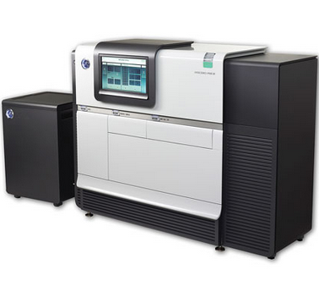
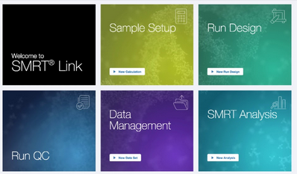
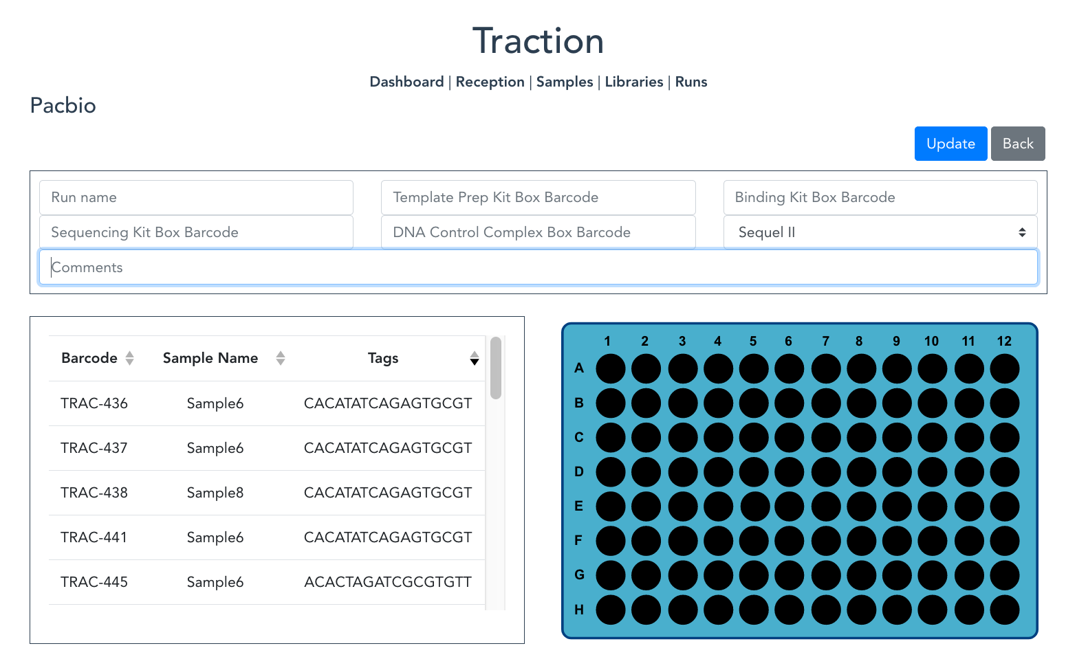
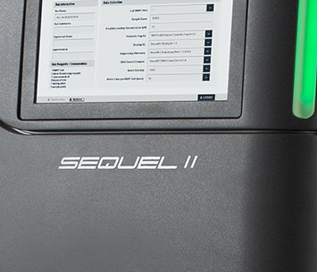
Pacbio
Notes:
Traction allows them to:
Import samples from samples extraction
Create libraries
Create runs
Generate sample sheets for importing into SMRT link
when a run is created data is automatically exported to the warehouse
Went live on November 21st
First 2 samples were created on November 27th
Libraries should be created this week
First run in before Christmas

Slide 15
COMING SOON
Notes:
Whats coming next for Traction

Slide 16

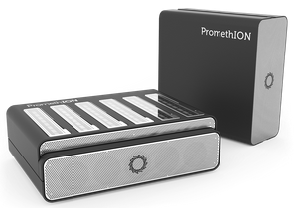
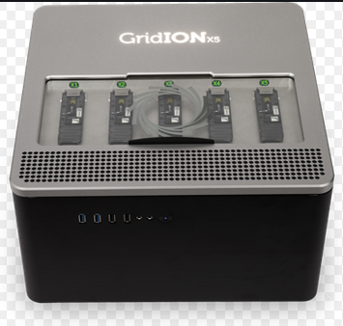
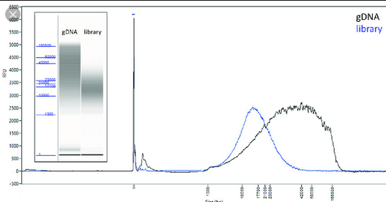
ONT and Pacbio
Notes:
Short term for Traction
PacBio
Multiplexing – currently being worked on as we speak should be released early January
Add tracking support for QC and femto pulse, images, – should be delivered second quarter on 2020
After that we hope to add further support for other Oxford Nanopore Technologies
ONT
Specifically Promethion – sample reception, QC, library and run creation, data export to warehouse (work starting in January 2020)
And hopefully Collaborate with Genomics England , as they are looking to scale up their Promethion work, and are looking to collaborate with us
Gridion – move functionality from old traction
- Add automation on run creation
as throughput increases, it will become crucial
To prevent duplication of work
As traction talk to ONT instruments API
create runs via the ONT instruments API
prevents duplication of effort and extract information about runs to provide live updates of how runs are progressing

Slide 17
THANK YOU
Notes:
Thank you for listening and special thanks to
We will now pass you onto Andrew, who will concentrate on processes and science.

